Slide 1
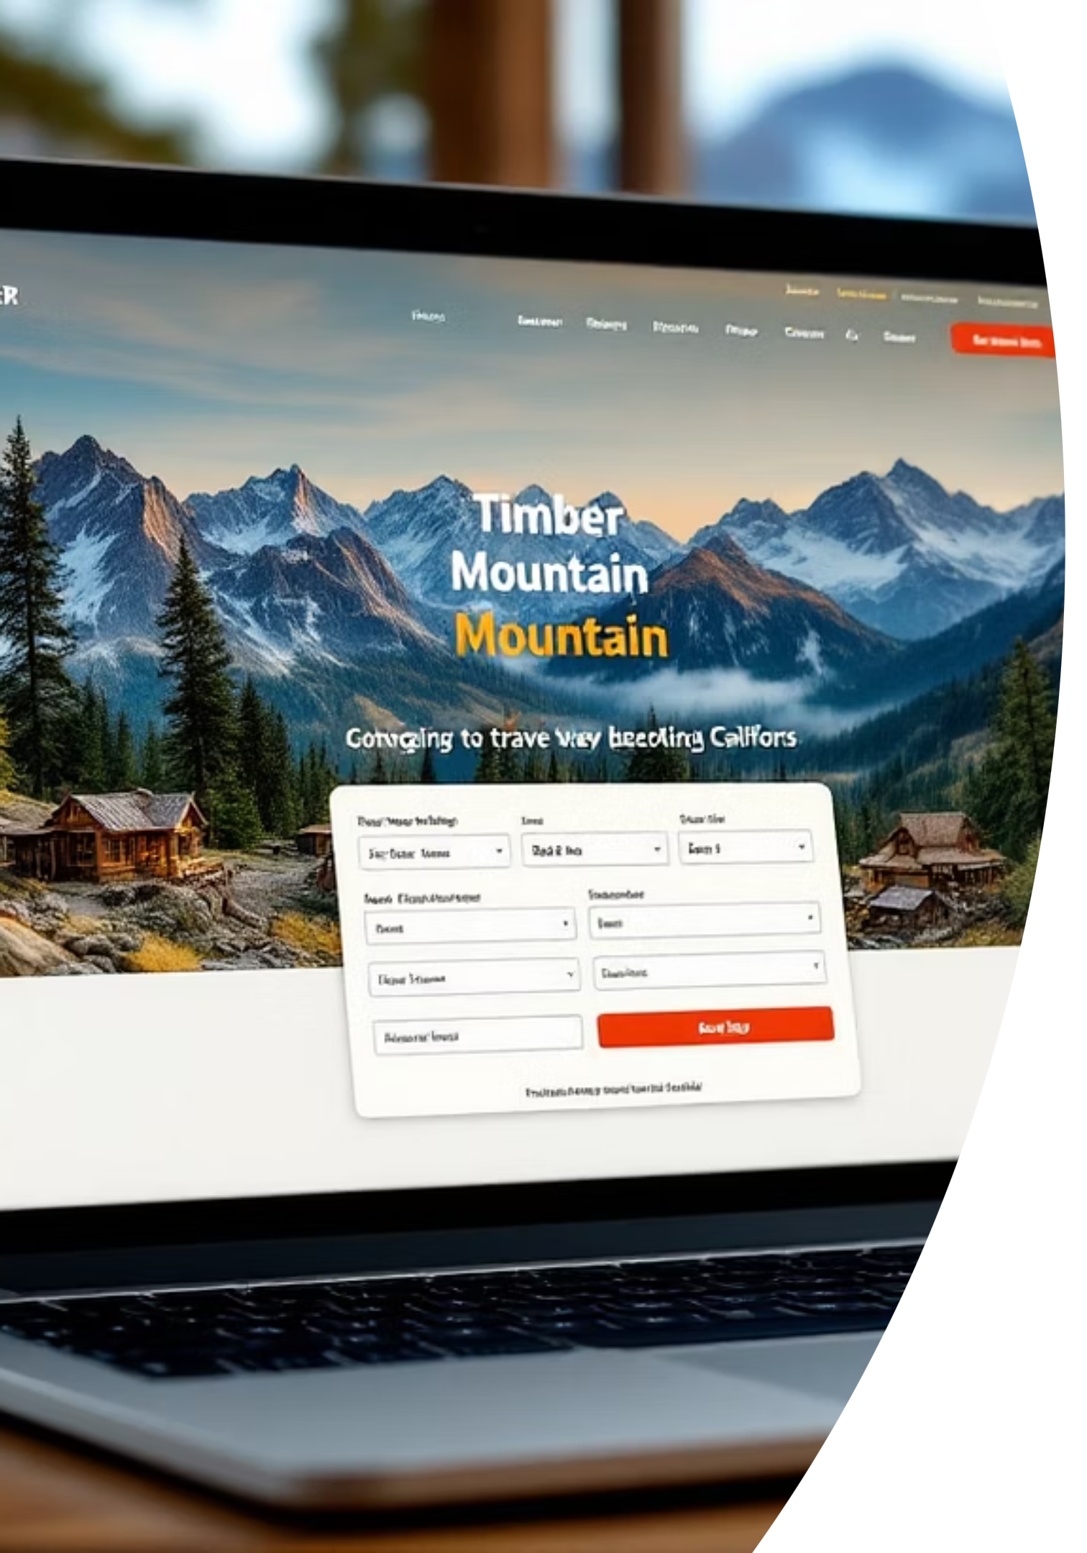

Timber Mountain: Unified Bundle Flow Checkout Test Results
A comprehensive analysis of our Seamless-Booking test initiative aimed at streamlining the checkout experience and increasing conversion rates.
by Andre Rand

Slide 2

The Checkout Problem
Our Legacy Funnel Was Losing Customers
Our traditional checkout process was causing significant customer drop-off:
7 separate checkout steps
3 domain hand-offs (Booking.com, airline GDS, rental-car sites)
42% drop-off after Step 3 (external redirect)
Highest abandonment for flights & hotels bundles
Customer feedback: "Felt sketchy clicking through all those different sites."

Slide 3

Our Hypothesis
We believed we could significantly improve the customer experience by creating a more streamlined checkout process.
If we replace the multi-redirect flow with a single, Booking.com-powered in-page bundle checkout, overall booking-completion will rise by ≥10% for U.S. visitors who add at least one non-ticket item.

Slide 4
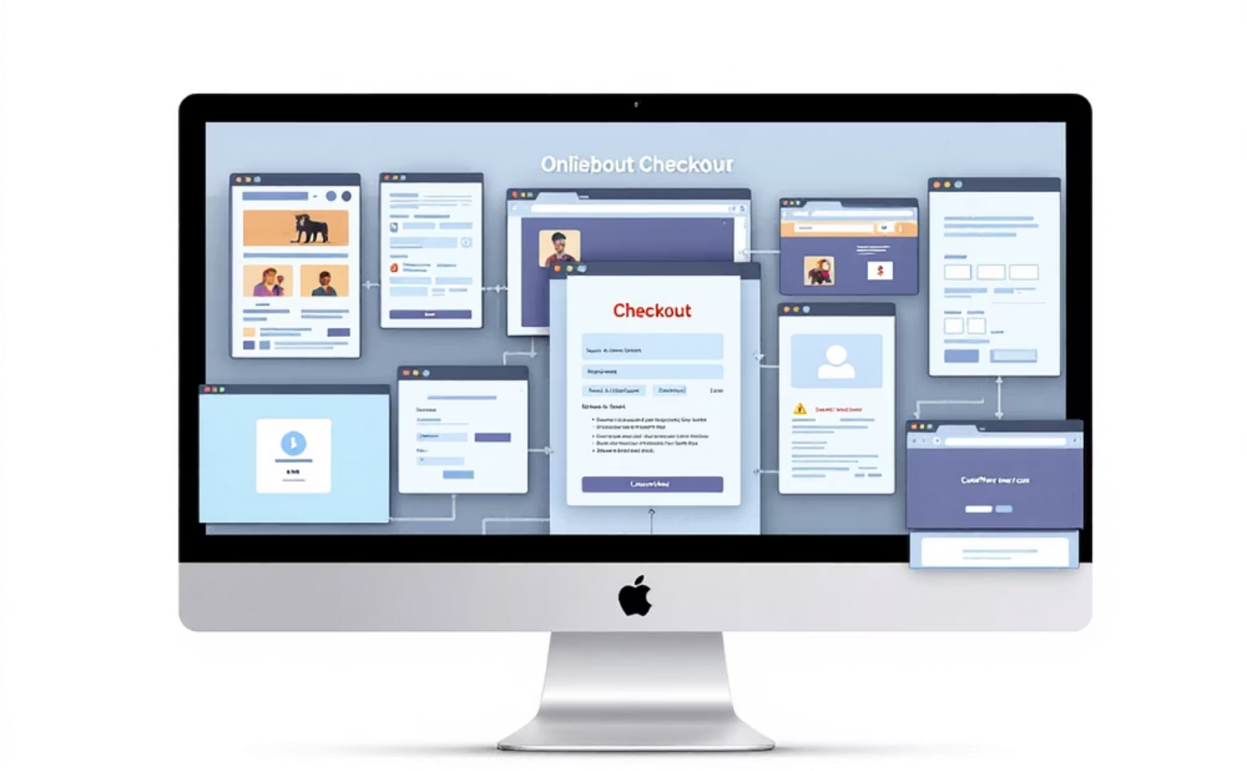
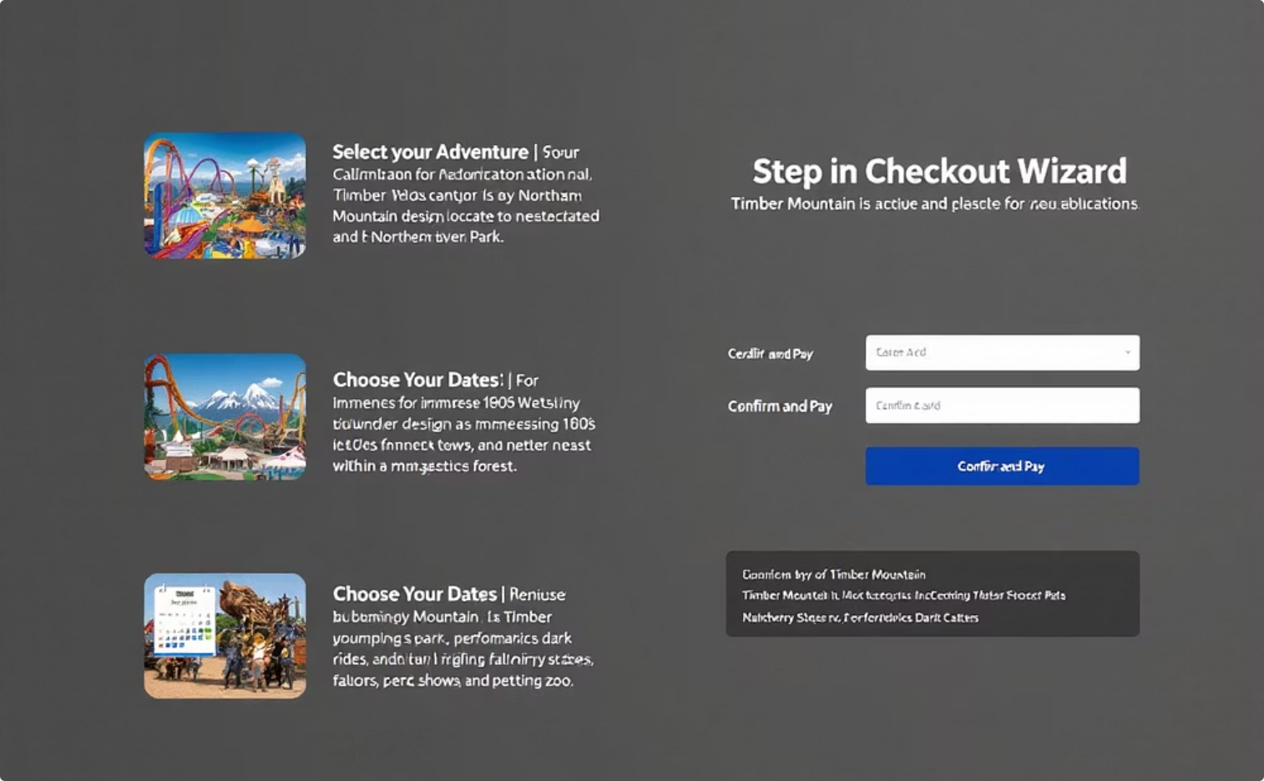
UX Comparison: Control vs. Treatment
Control: Legacy Checkout
Treatment: Unified Flow
7-step funnel with multiple screens
3-step in-page wizard (Review → Passenger Info → Pay)
Redirects to external domains for flights, hotels, cars
Booking.com iFrame handles all bundle SKUs
Separate payment screens for each component
One PCI-scoped payment call
Inconsistent branding across touchpoints
Consistent Timber Mountain branding throughout
Technical Note: If Booking.com API response time exceeded 250ms (occurring in 0.6% of sessions), users were gracefully redirected to the Control experience.

Slide 5
Test Parameters & Methodology
Geographic Focus
United States only
Target Audience
Visitors who added ≥1 flight, hotel, or car rental to cart
Test Duration
September 2-22, 2024 (3 weeks)
Traffic Split
50/50 at session start
Primary KPI
Booking-completion rate (all items in cart purchased)
Secondary Metrics
Flight-only completion, Hotel-only completion, Checkout duration
Guardrail Metrics
Average order value, 95th-percentile First Contentful Paint
Statistical Method
Two-tailed z-test, α = 0.05; 95%+ power

Slide 6
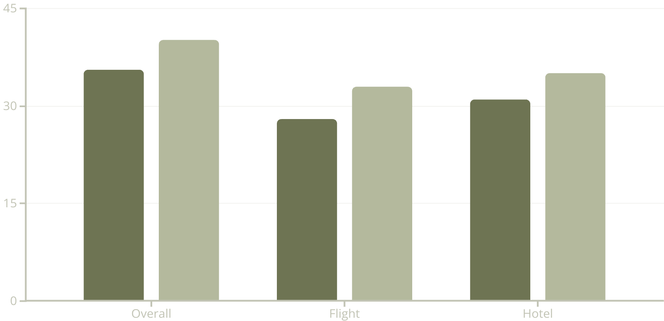

Results: Primary Metrics
Significant Improvements Across All Categories
+12.7% increase in overall booking completion (p=0.006)
+5 percentage points in flight bookings (p=0.015)
+4 percentage points in hotel bookings (p=0.021)
The greatest improvements were seen in the areas where we previously experienced the highest abandonment rates, confirming our hypothesis that a streamlined checkout experience would have significant impact.
Control
Treatment

Slide 7

Results: Secondary Metrics
57%
50%
18pp
Reduction in Checkout Steps
Faster Checkout Time
UX Satisfaction Increase
From 7.0 steps in control to 3.0 steps in treatment
From 4m 12s (control) to 2m 05s (treatment)
More users reported "checkout felt easy" in qualitative surveys
0.9%
Performance Impact
Minimal increase in 95th-percentile FCP (statistically insignificant at p=0.74)

Slide 8
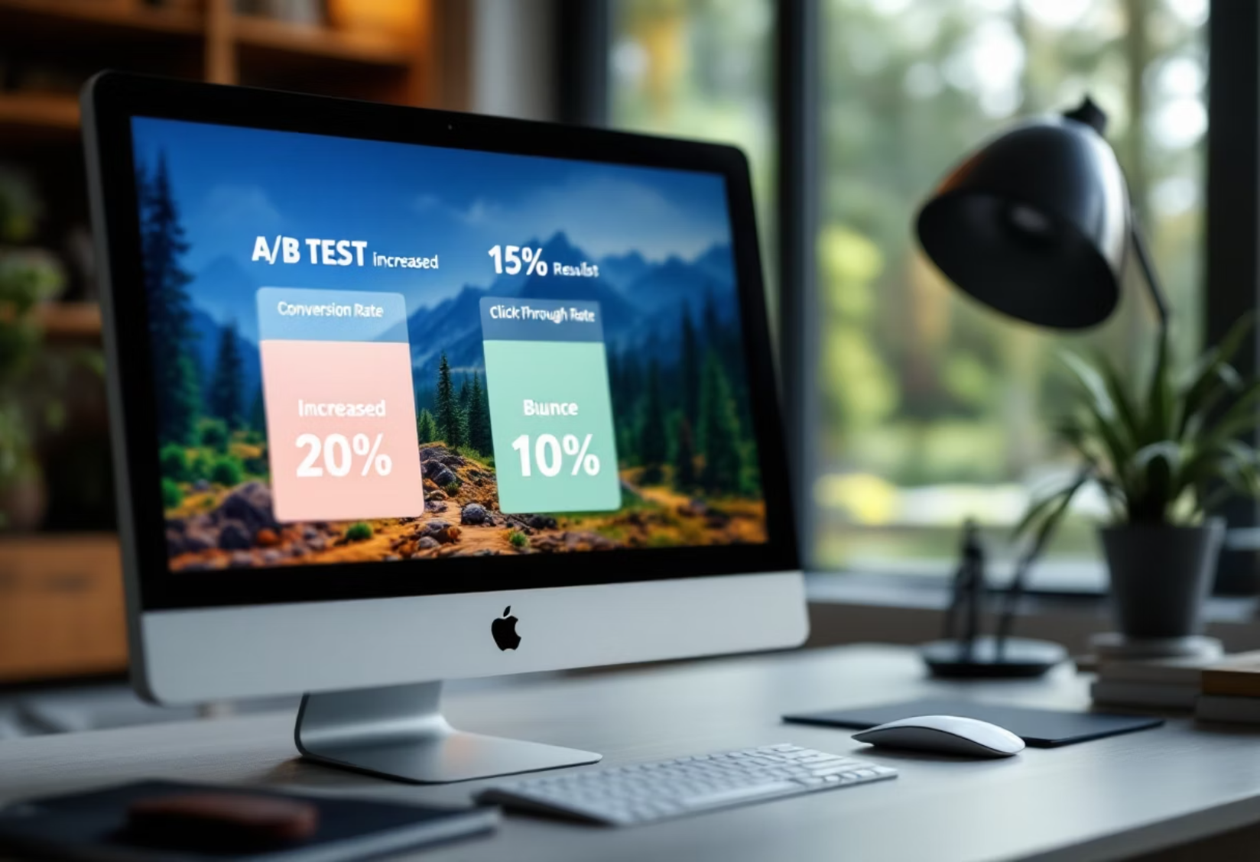
Hypothesis Confirmed
The integrated Booking.com bundle flow delivered:
Statistically significant +12.7% uplift in completed bookings
No negative impact on performance metrics
Maintained average order value
Directly addressed the "Seamless Integration" friction point
Projected Annual Impact (U.S. Traffic Only)
≈ +36,000 additional completed itineraries
≈ +$2.4M incremental revenue (based on $67 blended ARPU)

Slide 9
Next Steps: Implementation Plan
U.S. Roll-Out
Full deployment to 100% U.S. traffic with 5% hold-back for ongoing monitoring and comparison
International Expansion
Run identical tests in Canadian and UK markets to validate regional performance
Optimization Opportunities
Launch in-wizard upsell experiments for add-ons (meal plans, express passes, priority boarding)
Technical Safeguards
Implement performance guard-rails with alerts if 95th-percentile FCP drifts more than 50ms
Cross-Device Experience
Develop persistence of the in-page bundle during mobile app hand-off scenarios

Slide 10

Key Takeaways
Frictionless Checkout Drives Conversion
The 12.7% increase in booking completion demonstrates that reducing steps and keeping users within our ecosystem significantly improves conversion.
Speed Matters
Cutting checkout time in half while maintaining performance metrics shows that efficiency and user experience can be improved simultaneously.
Revenue Impact Is Substantial
With a projected $2.4M annual revenue increase from U.S. traffic alone, the global potential of this improvement is significantly higher.

